Slide 1
Angular Forms
Hardeep Kaur Dhalla

Slide 2
Objectives
Angular Forms

Slide 3
Angular forms
Angular provides two different approaches:
Reactive
template-driven.
Both
capture user input events from the view,
validate the user input,
create a form model and data model to update,
and provide a way to track changes.
Both approaches process and manage form data differently.

Slide 4
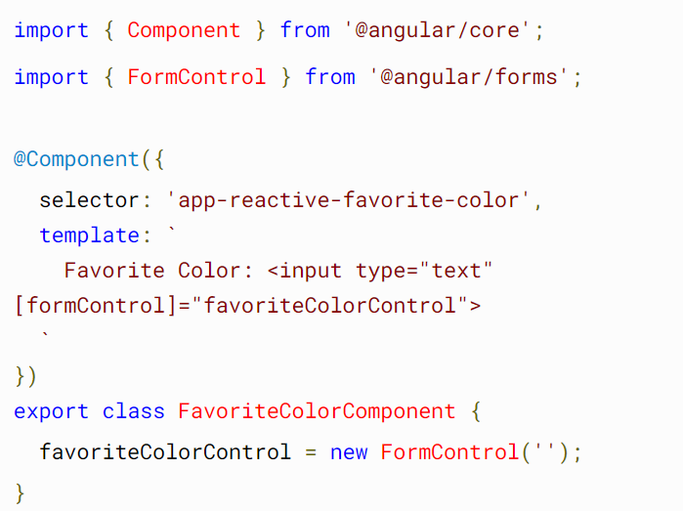
Setup in reactive forms

Slide 5
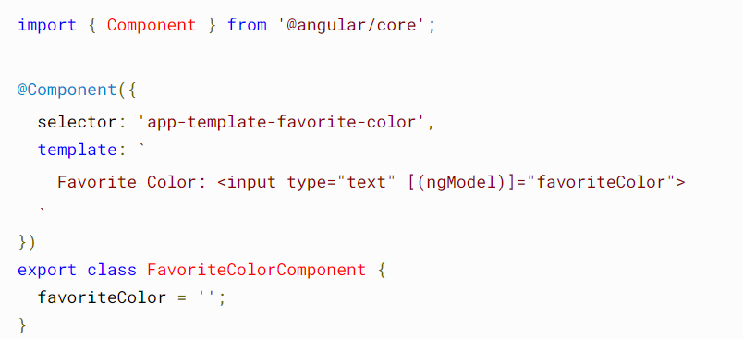
Setup in template-driven forms
The directive NgModel creates and manages a FormControl instance for a given form element.
You do not have direct programmatic access to the FormControl instance.

Slide 6
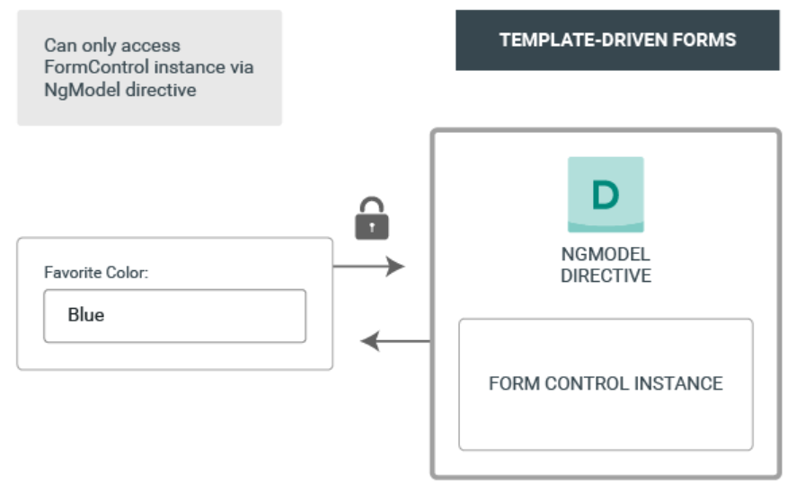

Slide 7
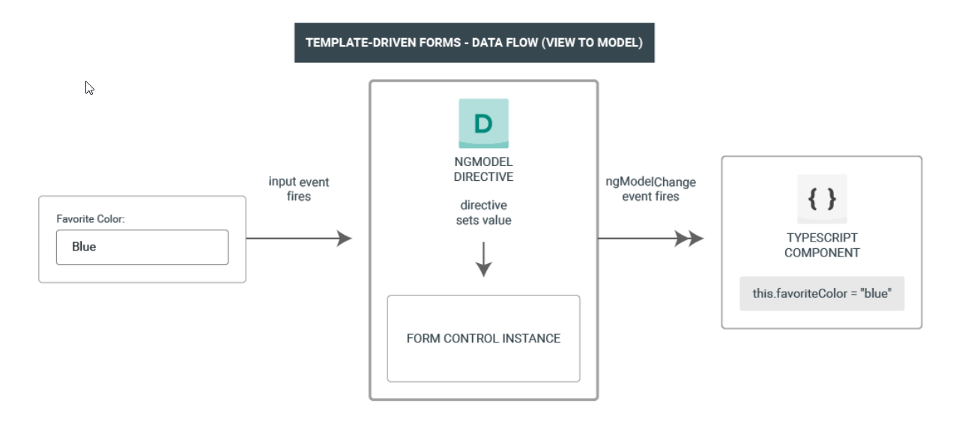
Data flow in template-driven forms
In template-driven forms, each form element is linked to a directive that manages the form model internally.

Slide 8
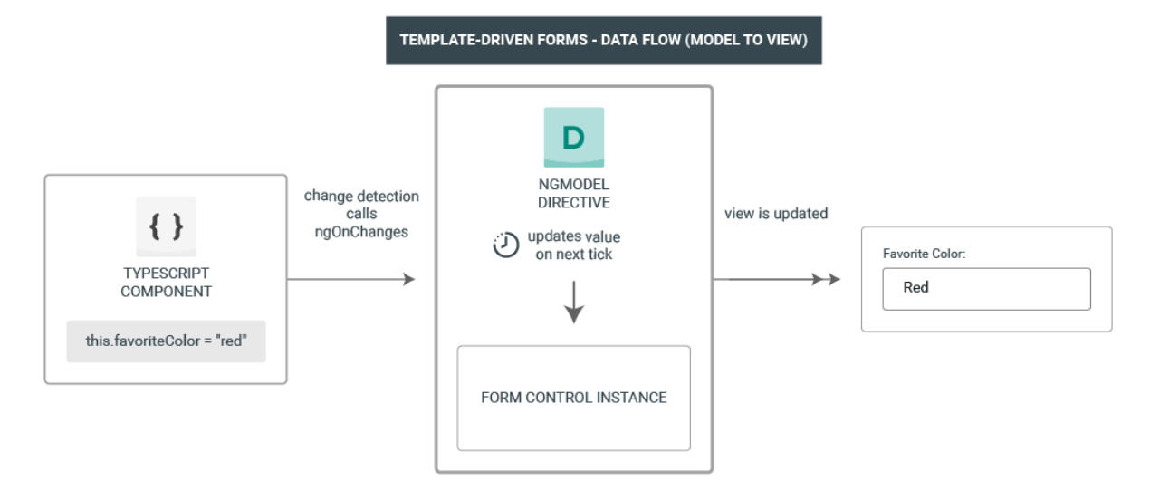
Data flow in template-driven forms

Slide 9
The FormControl class
A FormControl represents a single input field.
The FormControl instance
tracks the value,
user interaction,
and validation status of the control
and keeps the view synced with the model.

Slide 10
NgForm
if you import FormsModule, NgForm will get automatically attached to any <form> tags you have in your view.
You optionally export the directive into a local template variable using ngForm as the key
ex: #myForm="ngForm"
It provides a FormGroup instance (which tracks the value and validity state of a group of FormControl instances) and ngSubmit event .

Slide 11
ngModel
To register child controls with the form, use NgModel with a name attribute.
We can add one-way data binding using ngModel with [] syntax.
We can also add two-way data binding [()] syntax.
To inspect the properties of the associated FormControl, export the directive into a local template variable using ngModel as the key
ex: #myTemplateVar="ngModel“

Slide 12
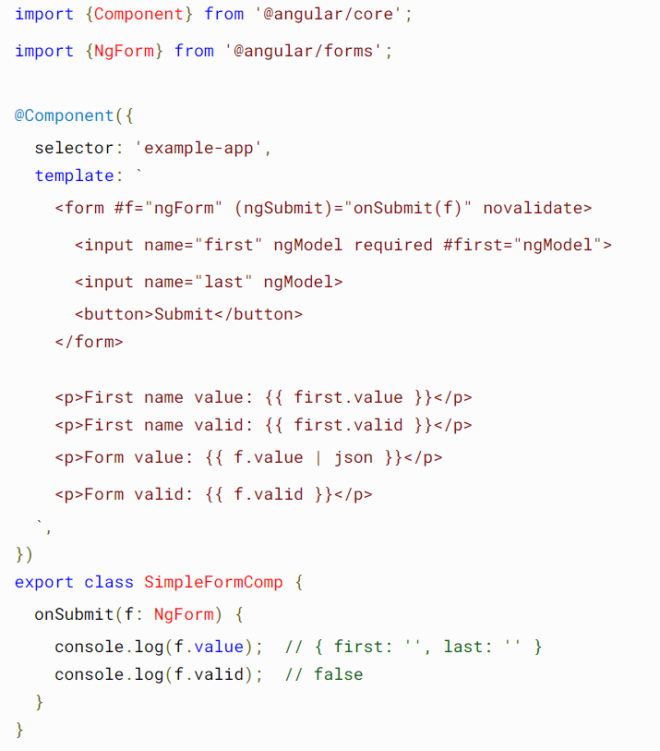

Slide 13
References
https://angular.io/guide/forms-overview#introduction-to-forms-in-angular

